Slide 1


Resumes & Cover letters
Presented by Suzanne Sumsion University Inn, Rm. 102 www.usu.edu/career (435) 797-7777
EXPLORE
OBTAIN
PREPARE
SUCCEED

Slide 2
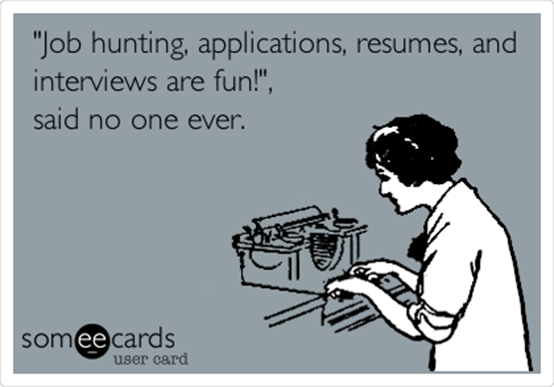
Purpose of a Targeted resume
Land an interview
Remind the interviewer of your skills
Justify the hiring decision to others
Is your personal brand

Slide 3
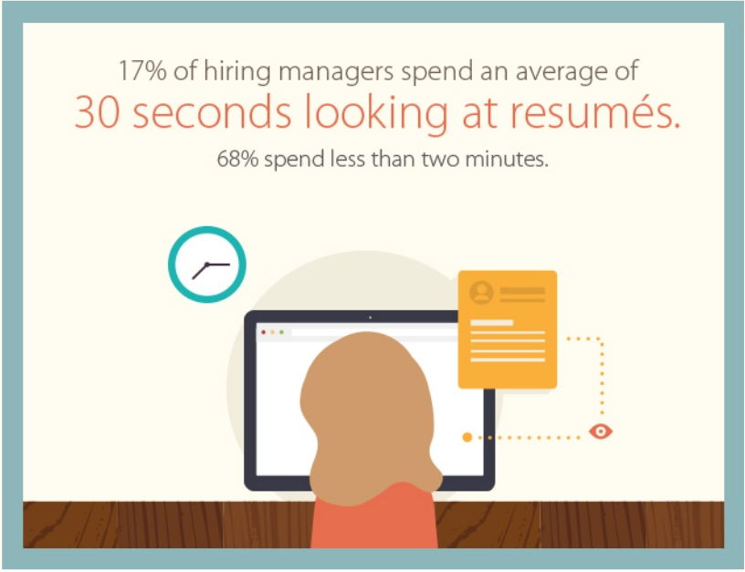
Unbreakable Rules according to hiring managers
Forgetting to include keywords
Too much text
Personal Pronouns
Too many bullets
Outdated, hard-to-read- fonts
Present tense for past jobs
Inconsistent formatting
Social-media URLs that aren’t related to the position
Spelling and grammar mistakes
A less-than-professional email address
2017, Business Insider

Slide 4

avoid the trash bin – Formula for a winning resume
Mistake 1: Typos
Mistake 2: Length
Mistake 3: Formatting
Mistake 4: Confidential/Protected information
Mistake 5: Lies
Lazlo Block, SVP, People Operations at Google, 2014

Slide 5
Skills/Qualities Employers Want
ATTRIBUTE | % OF RESPONDENTS
1. Ability to work in a team | 78.0%
2. Problem-solving skills | 77.3%
3. Communication skills (written) | 75.0%
4. Strong work ethic | 72.0%
5. Communication skills (verbal) | 70.5%
6. Leadership | 68.9%
7. Initiative | 65.9%
8. Analytical/quantitative skills | 64.4%
9. Flexibility/adaptability | 63.6%
10. Detail-oriented | 62.1%
11. Interpersonal skills (relates well to others) | 58.3%
12. Technical skills | 56.8%
13. Computer skills | 49.2%
14. Organizational ability | 47.7%
15. Strategic planning skills | 37.9%
Job Outlook 2017, National Association of Colleges and Employers

Slide 6
Influence of attributes (Based on a 5-point scale; 5 = extreme influence)
ATTRIBUTE | 2017 AVERAGE INFLUENCE RATING*
Major | 4.0
Has held leadership position | 3.9
Has been involved in extracurricular activities (clubs, sports, student government, etc.) | 3.6
High GPA (3.0 or above) | 3.6
School attended | 2.9
Has done volunteer work | 2.6
Is fluent in a foreign language | 2.1
Has studied abroad | 2.0
Job Outlook 2017, National Association of Colleges and Employers

Slide 7
Header samples
BRADY SMITH
_______________________________________________________________________________________
linkedin.com/in/bsmith (435) 797-1234 mye-mail@gmail.com
Jennifer Seamons
455 North 1100 East
Logan, UT 84321
435.752.1010
mye-mail@gmail.com
Things to consider:
Link to online portfolio, blog, or LinkedIn account
Mailing address is optional

Slide 8
Objective & headline samples
Apply software development experience as a programmer
with Iridium Communications
A Mechanical Engineering Position with ATK
Mechanical Engineer
Design Analysis Problem-Solving
________________________________
JOHN STAFFORD
Seeking Computer Science Position
_________________________________

Slide 9
Education sample
Master of Science, Computer Science December 20xx
Utah State University (USU), Logan, UT GPA 3.94/4.0
Emphasis: Computer Security
Bachelor of Engineering, Computer Science May 20xx
University of Madras, Chennai, India Top 10% of class
EDUCATION:
B.S. Degree, Mechanical Engineering May 20xx
Utah State University, Logan, UT 3.45 GPA
Financed education by working part-time

Slide 10
Success statements: Show me don’t tell me!
A good success statement used in effective resumes should:
Start with an action VERB and briefly describe a skill, responsibility, or task
Identify any tools or processes (computer programs, team efforts, equipment) used to accomplish the above
Use numbers to show results and scope/scale of your success
Be represented as a bullet point (not written as a complete sentence-no personal pronouns or periods)
Accomplished [X] as measured by [Y] by doing [Z]

Slide 11
Success statement Examples
Engineered network simulator in a Linux environment using Java as a proof of concept for research on proposed satellite technology
Designed and developed a black box test suite in a Linux environment using Java for the plug and play satellite software for customers to use while testing their implementation of plug and play components.
Architected a comprehensive set of unit tests as a white box testing strategy for plug and play satellite software test suite as a quality assurance measure
Formulated and executed test plans and test cases for functional testing of software.
Carried out penetration and security testing on aspects of software, finding several areas that were vulnerable to SQL injection attacks
Devised and implemented plans for Load testing of software simulating thousands of users across a network using Microsoft Load Test Utility

Slide 12
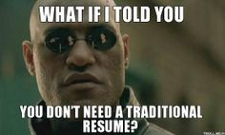
Before You Start, Ask Yourself
“Is my work experience related to the job I'm trying to get?”
If yes, consider using a traditional chronological resume
If no, consider using a skills resume (functional)

Slide 13
Chronological resume sample
INTERNSHIP EXPERIENCE
Computer Science Intern, Summers 20xx and 20xx
Digital Receiver Technology, Inc. Ventura, CA
Wrote KeyCreator, a program used to generate software installation keys
Conducted hardware and software testing for a small growing government contracting company specializing in intelligence equipment
ADDITIONAL WORK EXPERIENCE
Telephone Interviewer, October 20xx to May 20xx
Information Alliance, Logan, UT
Refined interpersonal communication skills while conducting telephone surveys daily over the telephone
Consistently exceeded call volume goals
Food Server, August 20xx to Present
Village Inn, Logan, UT
Developed and improved ability to relate well with all types of people
Served large groups efficiently in a fast-paced environment
Learned to multi-task, problem-solve, and pay attention to detail

Slide 14
Chronological resume sample (continued)
RELATED PROJECTS
Wrote a C++ program with GUI to control a video camera that would zoom, tilt, and pan based on user input
Used Perl, HTML, and JavaScript to write a script that takes user input from web page, modifies another web page according to the input, displays the new web page and emails results to an administrator
Created a program that would generate installation keys for DRTi’s software using MFC and C++
Participated on team of four to design flight mechanics of aircraft that took first place in national student competition
Served as team leader for group project analyzing incompressible flow over finite wings
Completed a conceptual design and technical report of a theoretical imaging satellite in LEO

Slide 15
Chronological resume sample (continued)
TECHNICAL
Computer, lab, language, field
Familiar with:
Knowledgeable in:
COMPUTER SKILLS
Maple C++ LabView Sinda-G
Fortran MATLAB Excel Access

Slide 16
Chronological resume sample (continued)
LEADERSHIP/VOLUNTEER EXPERIENCE
Service Coordinator, ASME Student Chapter, USU, 20XX to Present
Volunteer Math Tutor, STICKS Program, Fall Semester 20XX
Spanish-Speaking Volunteer, Religious Non-Profit Organization, Baja, Mexico, 20XX-20XX
VOLUNTEER AND LEADERSHIP EXPERIENCE
Vice President, ACM, USU, 20XX-20XX
Tutored 12 elementary-age students in math for nine months
Helped chapter receive “Superior” national ranking

Slide 17
skills Resume sample
RELEVANT SKILLS AND EXPERIENCE
Database and Database Tools (Postgres, MySQL, SQLYog, pgadmin)
Optimized queries for the Computer and information Literacy (CIL) Lab at Utah State University to reduce response time from three minutes to ten seconds
Backed up sales database, created SQL queries and reports using XSL for sales staff
Computer Security
Implemented a new model of Botnet infection to expose the weakness in existing defense mechanisms
Designed a defense against this model and validated the defense by implementing it on network of 40 virtual computers hosted on VMware ESX server (Master’s Thesis at USU)
Research
Researched and implemented an efficient Resume and Leads extraction algorithm
Developed a piracy prevention system for software products
Supervisory
Reviewed code of junior engineers as part of code review process
Mentored new hires
Held weekly brainstorming sessions with junior developers

Slide 18
Skills resume sample (continued)
WORK/LEADERSHIP HISTORY
President, USU Biology Student Club, Logan, UT, Fall 20xx – Present
Feature Writer, USU Statesman, Logan, UT, June 20xx – May20xx
Volunteer News Editor, USU Biology Dept., Logan, UT, 20xx – 20xx
Server, Café Sabor, Logan, UT, June 20xx – January 20xx
Spanish-Speaking Volunteer, Non-Profit Church Organization, Asuncion, Paraguay, 20xx – 20xx

Slide 19
Reference sample
BRADY SMITH
_______________________________________________________________________________________1098 N. 200 W., Logan, UT (435) 797-1234 mye-mail@gmail.com
REFERENCES
Mr. George Hildall Ms. Gale Strong
Manager of Production Training Director
ACME Company Tri Training
1234 Address Avenue 2948 SW Street
Los Angeles, CA 93099 Seattle, WA 94093
493-384-3382 382-555-3859
george.hildall@acme.com gale.str@tri.com
Previous Supervisor Former Employer

Slide 20
Remember…
Resumes get less than a one-minute scan
Write a targeted resume
Be sure your degree and key skills/experiences are at the beginning of your resume
Review/research job descriptions on the company’s website; focus on key words and skills
One page (consider two pages only if you are a returning or graduate student)
No grammar, spelling, typos, or format errors
Avoid templates and large blocks of text
Include a well-written, targeted cover letter

Slide 21
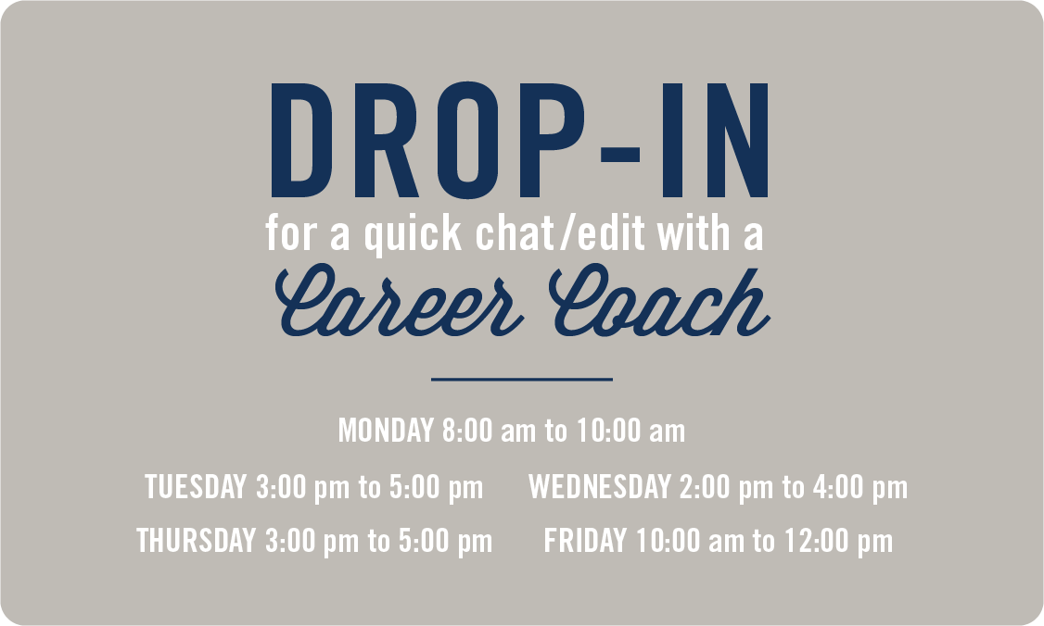






Questions?
Suzanne Sumsion
Career Coach, Engineering
Suzanne.Sumsion@usu.edu
Career Services, UI 102
Drop-In Hours in
ENGR Advising
Tuesdays from 3:00-5:00

